Slide 1
Caper:
Automatic Verification with Concurrent Abstract Predicates
Thomas Dinsdale-Young
Pedro da Rocha Pinto Kristoffer Just Andersen
Lars Birkedal

Slide 2
What is Caper?
caper /ˈkeɪpə/ noun
a frolicsome leap or spring
a frivolous escapade
a plant of the genus Capparis, or its pungent flower buds which are pickled and eaten
a tool for automatically proving programs using Concurrent Abstract Predicates (CAP)

Slide 3
Background: Separation Logic
Hoare-style program logic
{Precondition} code {Postcondition}
Assertions describe resources
Amenable to symbolic execution (e.g. Smallfoot)

Slide 4
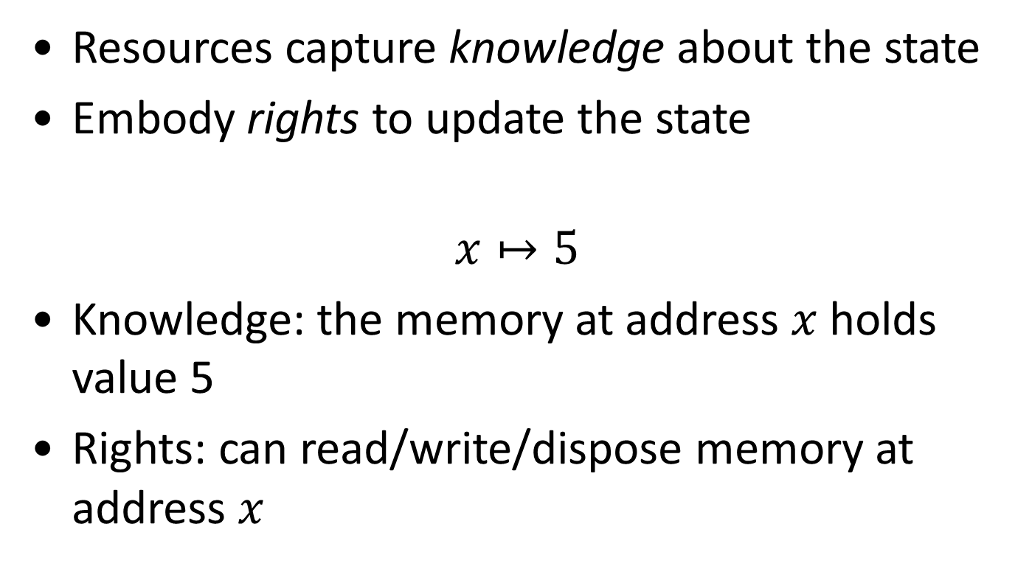
Resources
Resources capture knowledge about the state
Embody rights to update the state
$$x↦5$$
Knowledge: the memory at address $x$ holds value 5
Rights: can read/write/dispose memory at address $x$

Slide 5
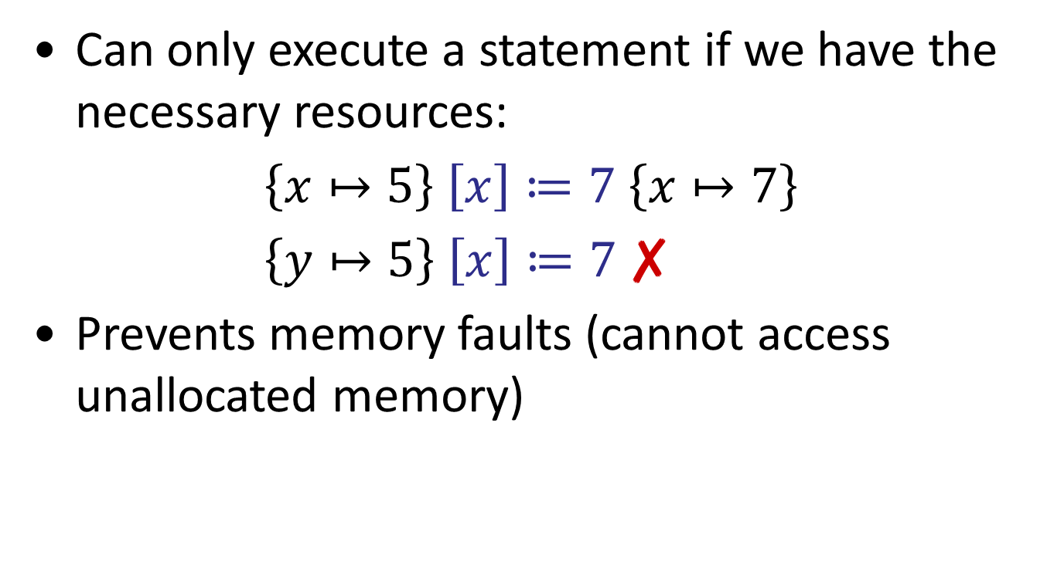
Symbolic Execution
Can only execute a statement if we have the necessary resources:
$\left\{x↦5\right\} \left[x\right]≔7 \left\{x↦7\right\}$
$\left\{y↦5\right\} \left[x\right]≔7$ ✘
Prevents memory faults (cannot access unallocated memory)

Slide 6
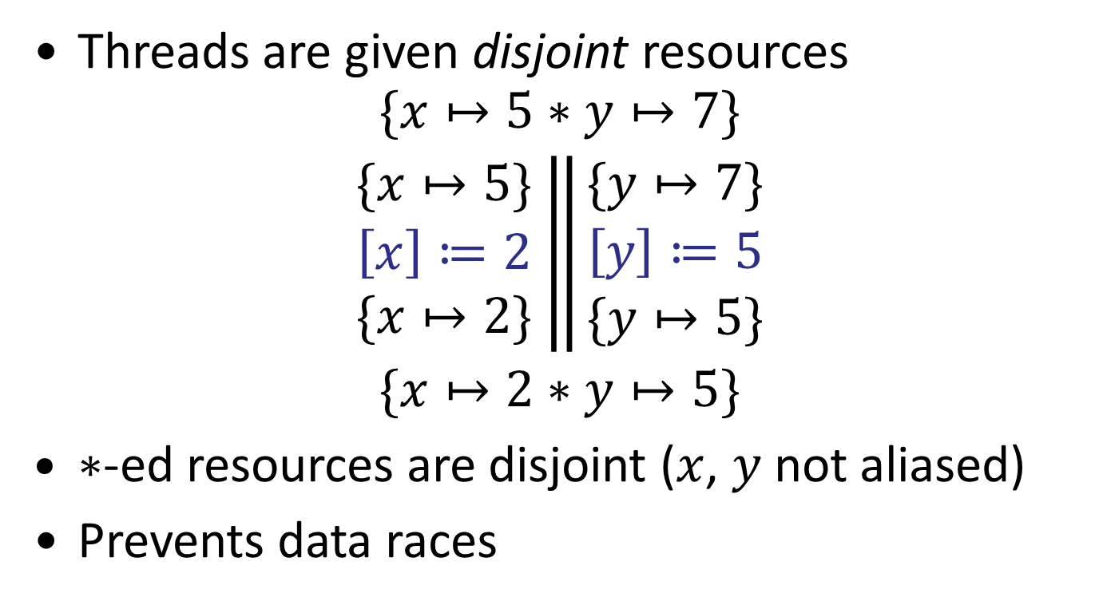
Concurrency
Threads are given disjoint resources
$$\begin{matrix}\{x↦5∗y↦7\} \\ \left.\begin{matrix}\{x↦5\} \\ \left[x\right]≔2 \\ \{x↦2\}\end{matrix} \right\|\begin{matrix}\{y↦7\} \\ \left[y\right]≔5 \\ \{y↦5\}\end{matrix} \\ \{x↦2∗y↦5\}\end{matrix}$$
$∗$-ed resources are disjoint ($x$, $y$ not aliased)
Prevents data races

Slide 7
Concurrent Abstract Predicates
CAP provides a way of specifying arbitrary knowledge and rights as resources
A region provides an abstraction over some shared resources
The region is equipped with a protocol that determines how threads can update it
Resources called guards determine the roles threads can play in the protocol

Slide 8
Example: Spin Lock
A spin lock region has two states: locked (1) and unlocked (0)
Any thread can update it from unlocked to locked
Only the thread that acquired the lock can update it from locked to unlocked

Slide 9
region SLock(r,x) {
guards UNLOCK;
interpretation {
0 : x |-> 0 &*& r@UNLOCK;
1 : x |-> 1;
}
actions {
: 0 ~> 1;
UNLOCK : 1 ~> 0;
}
}

Slide 10
Regions
Regions can be accessed only by atomic operations
A thread can only make updates that are permitted by the transitions for the guards it owns (Guarantee)
Between atomic steps, regions are stabilised by considering the updates other threads could make (Rely)

Slide 11
Demo: Spin Lock

Slide 12
Guards
Can specify multiple guards for a region type
Multiple guard types:
  Simple: UNLOCK UNLOCK
  Permissions: %LOCK LOCK[p]
  Set: #TICKET TICKET(n)
  TICKET{k|k<j}

Slide 13
Symbolic Execution
Consume resources
  Verification conditions sent to provers
Produce resources
symExWrite target expr = do
loc <- aexprToExpr target
check $ do
oldval <- newEvar "val"
consumePredicate (PCell, [loc, var oldval])
newval <- aexprToExpr expr
addPredicate (PCell, [loc, newval])

Slide 14
Region-aware Symbolic Execution
Open region(s) [non-deterministic]
  Produce interpretation [branch]
Symbolically execute atomic statement
  Consume resources
  Produce resources
Close regions(s)
  Consume interpretation [branch]
  Check that update to region is allowed by guards

Slide 15
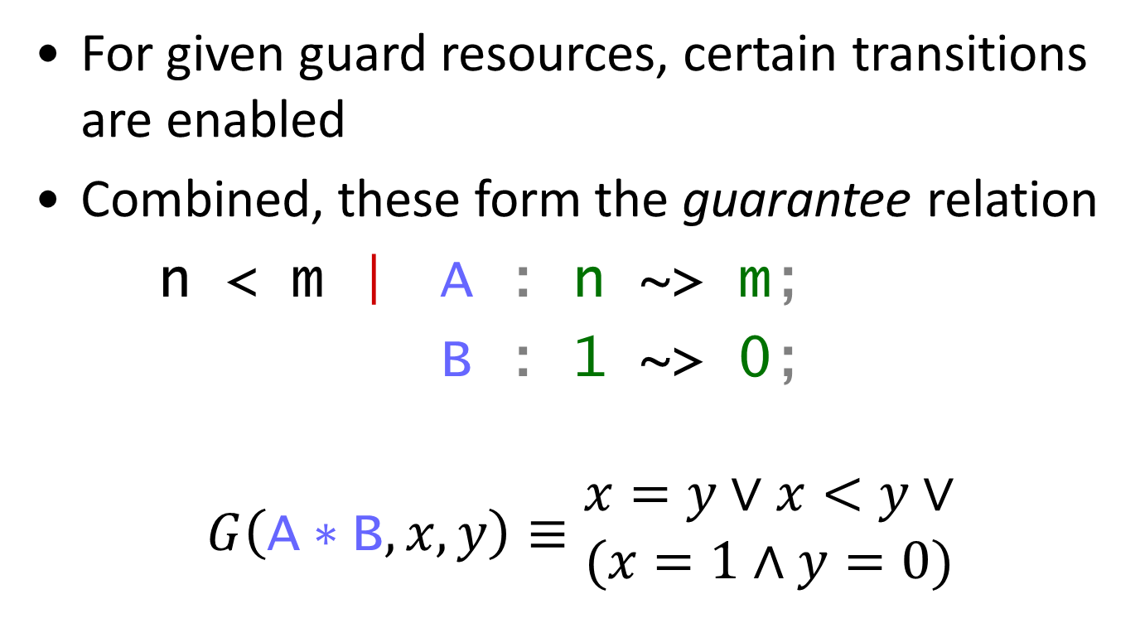
Guarantee Condition
For given guard resources, certain transitions are enabled
Combined, these form the guarantee relation
n < m | A : n ~> m;
B : 1 ~> 0;
$$G\left(\text{A}∗\text{B},x,y\right)≡\begin{matrix}x=y∨x<y∨ \\ (x=1∧y=0)\end{matrix}$$

Slide 16
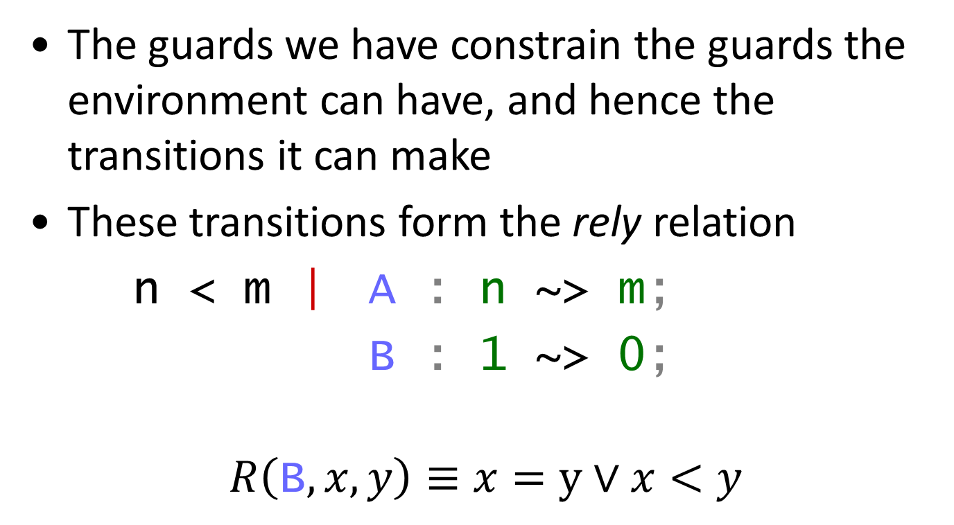
Rely Condition
The guards we have constrain the guards the environment can have, and hence the transitions it can make
These transitions form the rely relation
n < m | A : n ~> m;
B : 1 ~> 0;
$$R\left(\text{B},x,y\right)≡x=y∨x<y$$

Slide 17
Transitivity
Since the environment can take multiple steps, the rely relation must be transitively closed
Caper checks that the transition system is transitively closed
If the state space is finite, Caper can compute the transitive closure of the transitions
Otherwise, rely is overapproximated (badly)

Slide 18
The Provers
Caper produces two kinds of verification conditions
  Value conditions are sent to the Z3 SMT solver
  Permission conditions may be discharged by Z3, the E theorem prover or an internal prover

Slide 19
Demo: Ticket Lock

Slide 20
Design Philosophy: Choice
Non-determinism and back-tracking is built in to the core of Caper
  Which regions to open
  Which interpretations apply
Caper performs (fairly) exhaustive proof search
  Can be expensive
  Aim for common case first/good heuristics

Slide 21
Summary
Caper supports reasoning about concurrency through shared regions
Sharing is mediated by protocols, with roles determined by ownership of guard resources
Given the protocol and currently owned guards, Caper computes rely and guarantee relations as part of its symbolic execution

Slide 22
Future Directions
Support for richer abstractions
  Sets, lists, etc.
  Necessary for many interesting data structures
Improved proof/proof-search output
  Interactive navigation
  Certificate generation for external proof checker
Support for abstract atomicity

Slide 23
We that are true lovers run into strange capers; but as all is mortal in nature, so is all nature in love mortal in folly.
– Shakespeare, As You Like It (II, iv)

